Slide 1
RPRS (RENTAL PROPERTY RECOMMENDATION SYSTEM) GROUP MEMBERS: ASHWINI LELE
AYUSHI BANGAR DIVYADEEP NEEMA HARSHITA JAIN
HIMANSHI KUMRAWAT
MAYURI CHAUDHARY
Submitted to Department of Information Technology

Slide 2
Project Presentation Outline
Abstract
Introduction
Problem Statement
Survey of Existing Systems
Project Objectives
Requirement analysis
Solution Proposed
Models and diagrams
The implementation
The Outcome discussion
Conclusions and Limitations

Slide 3
Abstract
Rental Property Reccomendation System (RPRS) is a website which simplifies the problem of finding appropriate rooms and roommates to the people who are new to the city. It also provides convenient way for owners to rent their house. It also recommend rooms to tenants as per their interest.

Slide 4
Introduction
The project is divided in two modules.
1.Owner, who can upload details of his property which he want to rent. Also it will help owner to find tenant as per his/her wish.
2. Tenant, who can find desirable roommate via RPRS. He/she can search for new rooms as well.

Slide 5
The Problem Statement
Problem faced by outsiders:-
1. Lack of Knowledge about Localities.
2. Tenant’s also face problem to find desirable roommate to live with.
3.Only available in metropolitan cities.

Slide 6
Survey of existing system
S.NO | Existing System | Features | Advantages | Disadvantages
1. | 99acres.com | 1.Search residential 2.sell/rent property | 1.Frequently Asked Questions | 1.Can only Search for rooms.
2. | Property.mitula.in | 1.Home loan offers 2.Vehicles on rent | 1.Can search for apartments, land. 2.Roommates search available | 1.Non genuine calls.
3. | Locanto.net | 1.Premium account 2.Can search classes, jobs etc. | 1.Different categories | 2. Cheating people by taking money

Slide 7
Objectives
To develop a website, that will act as a bridge to connect tenant and owner.
To provide a solution for owner to find proper tenant.
To build a platform for tenant to find compatible room and roommates.
To provide room recommendation according to the users search history.
To reduce time and efforts of finding tenant and rooms.

Slide 8
Requirement Analysis
1 External Interface Requirements
There are many types of interfaces as such supported by this software system namely: User interface, Software interface.
1.1 User Interfaces
The user interface is implemented using internet browser. This interface is user friendly , So that every kind of visitor can find the rooms and roommates.
1.2 Software Interfaces
User should be able to rent out their room and find room or roommates.
1.3 Communications Interfaces
Communication function required the Internet protocol version 6 and it will follow HTTPS. It will use FTP for whole system with local server.

Slide 9
Requirement Analysis
2 Functional Requirements
2.1 Rent out Your Room
The owner of the house can register on the website and give the whole information about the house like address, area, bhk etc.
2.2 Find room
The person who wants the room on rent can also register on the website and search the rooms in the area they want. They can also contact the owner of the room.
2.3 Find Roommates
The person who wants the room partner can also register on the website and search the roommates by their choice.

Slide 10
Requirement Analysis
3 Detailed Non-Functional requirements
3.1 Reliability: System is reliable.
3.2 Performance efficiency
3.3 Security: Security purposes are up to the requirements.
3.4 Compatibility: Project is compatible to any system if its hardware requirements are specified.
3.5 Maintainability: New features can be added as per the requirement

Slide 11
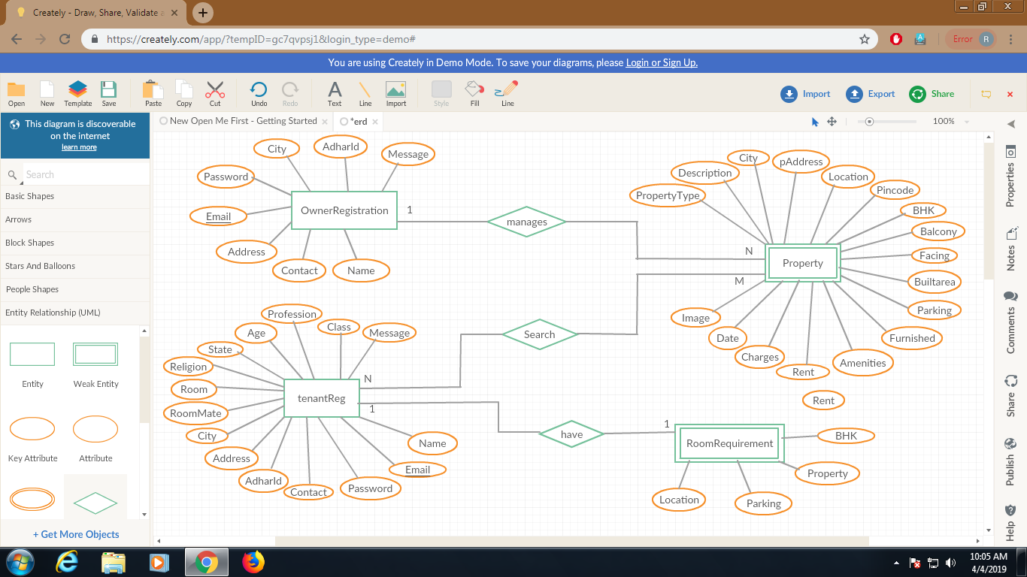
Models/Diagrams
ER-DIAGRAM:

Slide 12
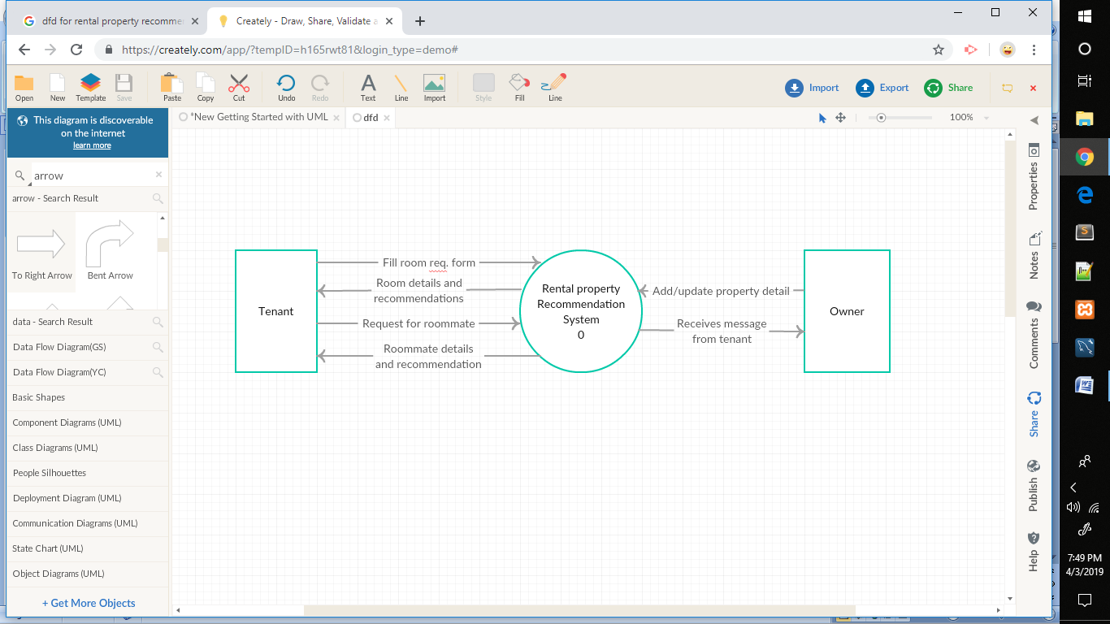
Models/Diagrams
LEVEL 0: DFD

Slide 13
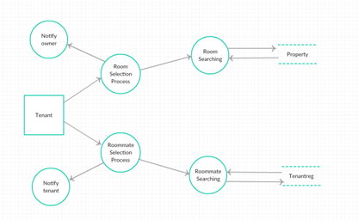
Models/Diagrams
LEVEL:1 :DFD

Slide 14
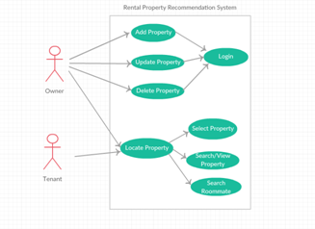
Models/Diagrams
USECASE:

Slide 15
Solution Proposed
We are providing two services to the user:-
Owner
Tenant

Slide 16
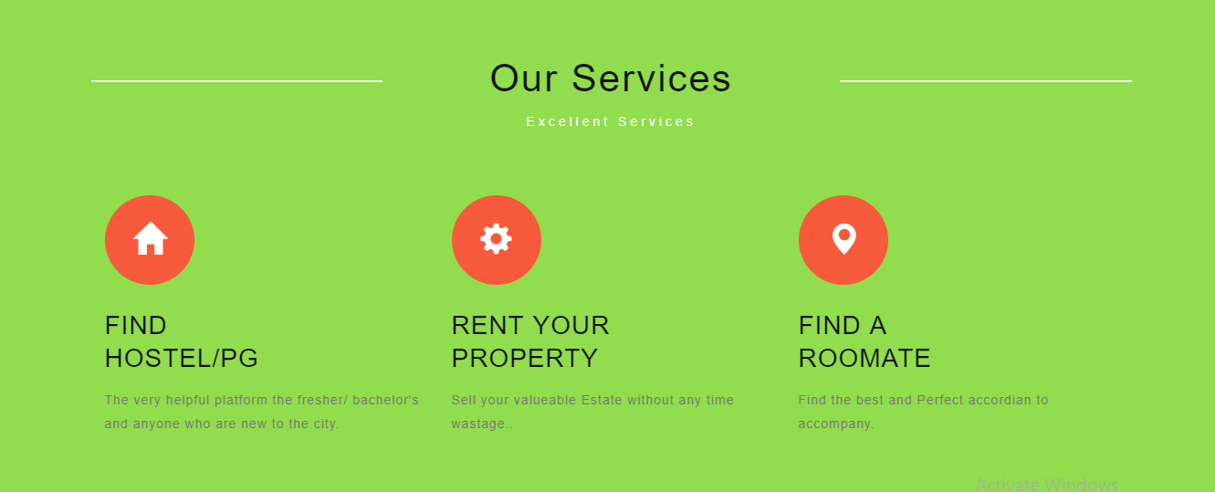
The implementation

Slide 17
OWNER
Services:-
Register
Add property
Search Tenant
Message
View notification
Update property/View property
Update profile

Slide 18
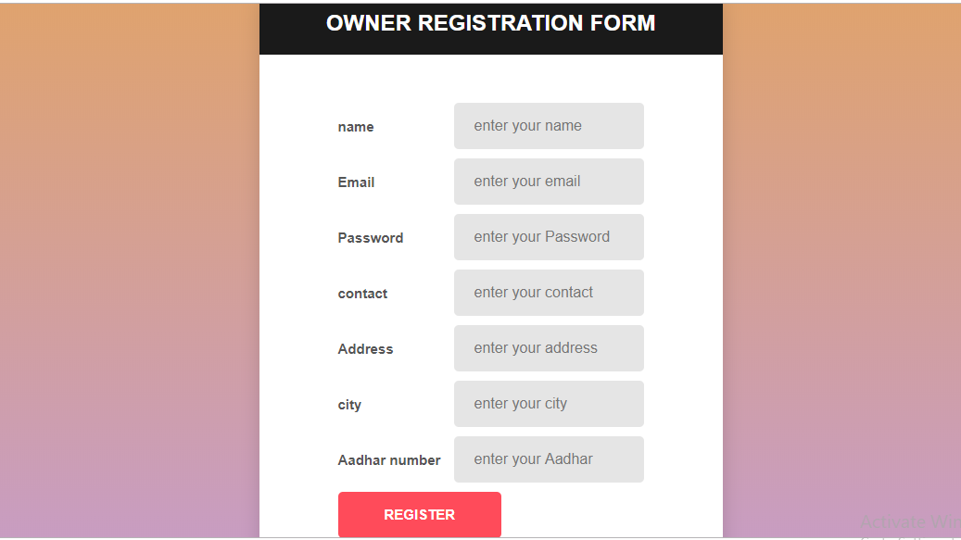
Owner : Registration

Slide 19
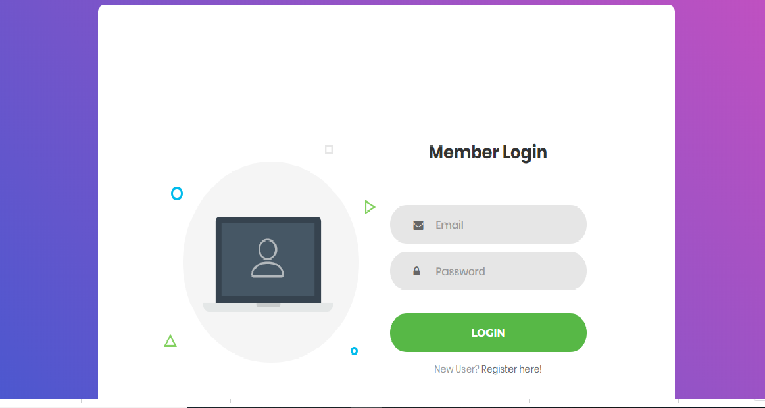
Owner : Login

Slide 20
TENANT
Services:-
Register
Find Room
Find Roommate
Message
View Notification
Update profile
Room requirement
Update requirement

Slide 21
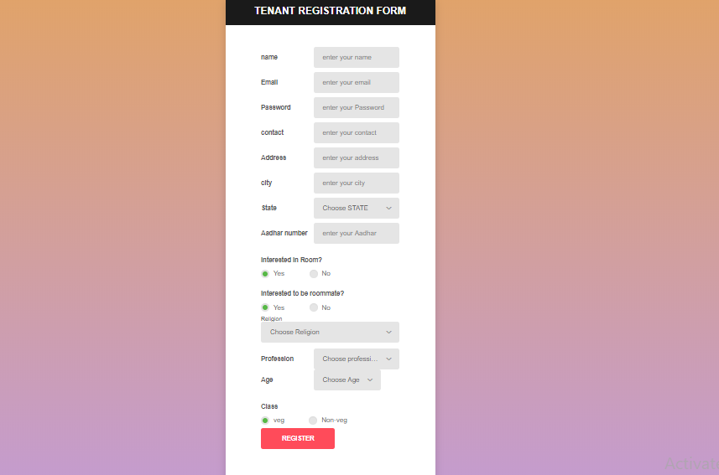
Tenant: Registration

Slide 22
Tenant: Login

Slide 23

The implementation

Slide 24
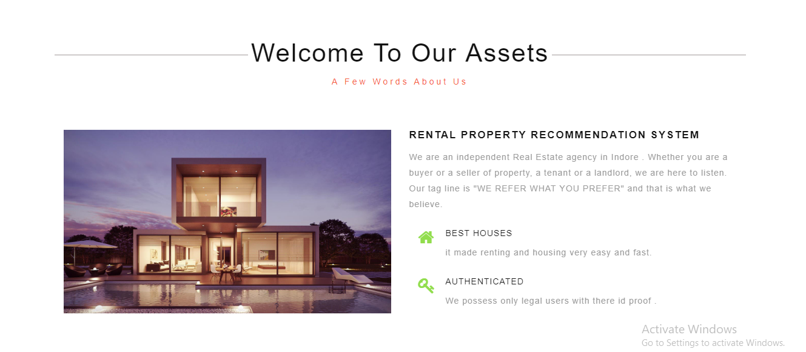
The implementation

Slide 25
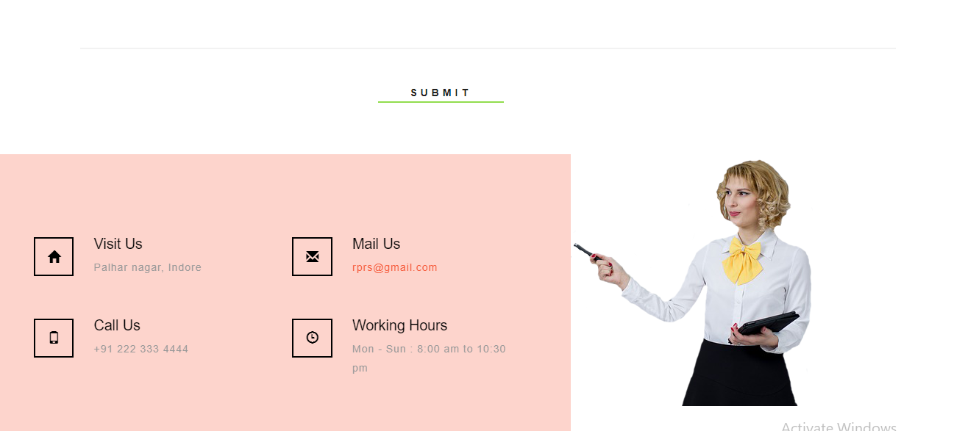
The implementation

Slide 26

The implementation

Slide 27
The Outcome discussion
Owner will be facilitated to rent their house.
It will also provide the facility to tenants to compare the house on the basis of location ,rent, bhk , facing as well as parking.
It will provide the facility to owner to find the tenant as per his requirement.
Ex:- some are only interested in giving room to family, some are interested in giving rooms to students etc.

Slide 28
Conclusion and Limitation
Conclusion :
This application provides a solution to the problem faced by the owners/tenants to search for the tenants for rent as well as finder to search for a living at rent and bring all related information in hands within a single click. This application uses data mining to give recommendation to the customers as per their choice.
Limitations:
There is no features of online payment.
Android application is not available.

Slide 29


